Slide 1
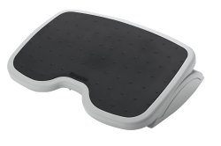
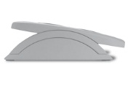
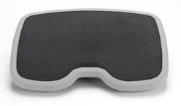
SoleMate™ FootRest
Product description
Footrests keep legs elevated for improved posture and circulation while you work at a desk and help reduce pressure on the lower back. They are easily adjustable for extra comfort, while there is a range of specifications available to suit individual requirements.
Product features
Tilts up to 20 degrees for additional comfort
Textured foot grip panel helps prevent slipping
Sturdy durable construction 450cm x 350cm (WxD)
Elevates legs to improve posture and circulation and reduce lower back pressure
Helps reduce pressure on lower back and alleviate discomfort from sitting
SKU: 56145

