Slide 1
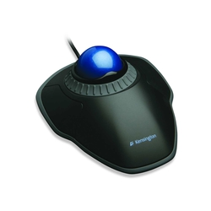
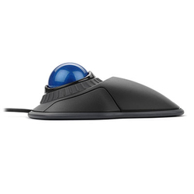
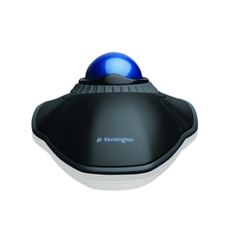
Orbit Trackball with Scroll Ring
Product description
All-day comfort and scrolling come together in the Orbit Trackball with Scroll Ring. The award-winning scroll ring allows you to spin through web pages and long documents without the need for clicking. It offers better ergonomics, with less wrist and hand movement that will ease the pain of repetitive-stress injuries
Award-winning Scroll Ring lets you scan up and down pages with ease
Medium 40mm ball is designed as a perfect sphere to provide exceptional precision
Optical tracking technology for superior cursor control and accuracy
Detachable wrist rest supports hand and wrist for ergonomic comfort
Ambidextrous design works equally well for both right-handed and left-handed users
Product features
SKU: K72337EU

