Slide 1

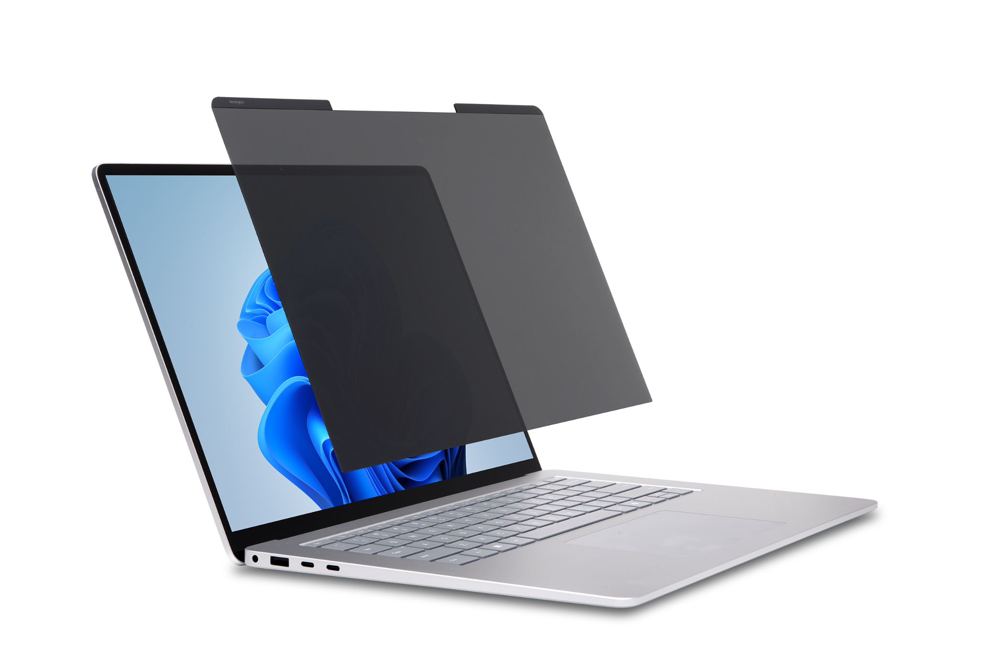
MagPro™ Elite Magnetic Privacy Screen
for Surface Laptop 15"
Designed exclusively for Surface
Seamlessly and easily attaches to the Surface Laptop’s magnetic frame
Reversible screen with matte and glossy sides
Limits viewing angle to ±30°
Reduces harmful blue light and glare and improves clarity
Touch and Surface Pen enabled
Protects screen
Includes protective case and cleaning cloth
2-year limited warranty
K58364WW

