Slide 1
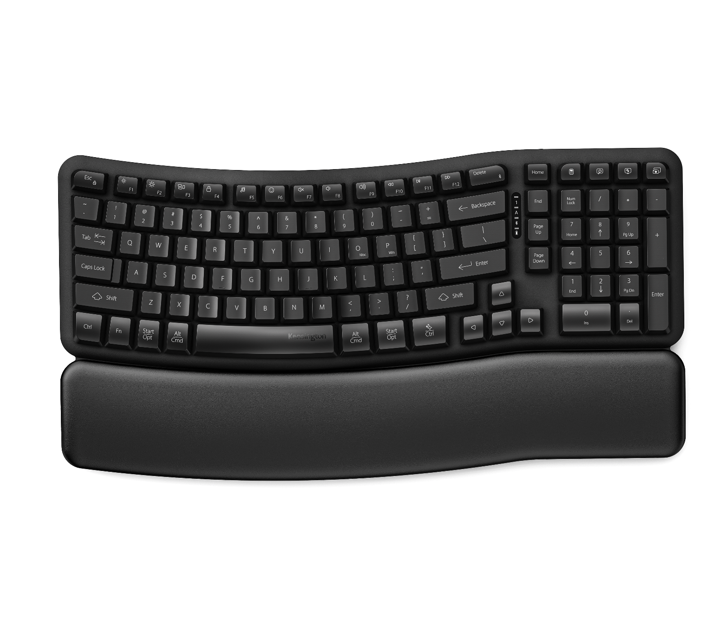

Pro Fit™ Ergo KB620-RC Wireless Rechargeable EQ Keyboard
post-consumer recycled
Ergonomic Wave Design Keyboard with Built-In Wrist Rest
Easy to learn and includes a memory foam wrist rest and adjustable tilt options.
Quiet, Responsive Typing
High-quality membrane key switches deliver a quiet and comfortable typing experience.
Programmable Keys*
Customize up to 20 keys with optional Kensington Konnect™ software.
Long-Lasting Rechargeable Battery
Up to 3 months** on a single charge. When it’s time to recharge, simply connect the included USB-C® cable.
LED Status Indicators
Indicators for Num Lock, Caps Lock, battery status, and device pairing.
1800 Layout
Preserves essential functionality while reducing overall desktop footprint.
Multi-Device Wireless Connectivity
Connect to three devices at once via 2x Bluetooth® connections and 1x 2.4GHz USB-A nano dongle. Compatible with Windows, macOS, and ChromeOS.
Sustainability Attributes
Outer case and keycaps contain 49% post-consumer recycled (PCR) content and it ships in FSC® certified packaging.
Kensington Quality & Warranty
Tested for durability and backed by professional support and a 3-year limited warranty.
K72487NA/UK
*Programmable buttons and shortcuts are optimized for Windows and macOS. Some ChromeOS shortcuts and customization features may not be supported.
**Battery life may vary based on usage.

