Slide 1

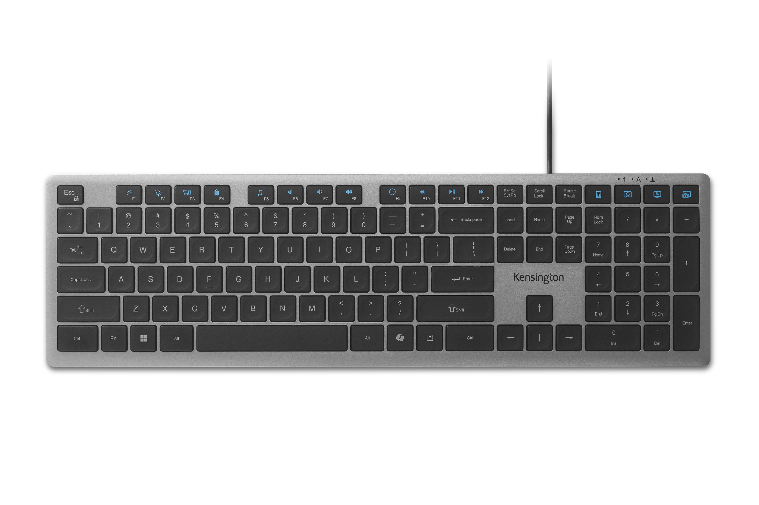
KB515 EQ USB-A Wired Keyboard
16 Programmable Keys + AI Copilot Key for Enhanced Productivity - Streamline demanding workflows or enhance your gaming experience with 16 programmable keys, a dedicated AI Copilot key*, and Function Lock.
Reliable Wired Connection for Zero Latency Performance - Delivering high-speed performance, this keyboard features a 5ft (1.5m) wired USB-C® connection with tethered USB-A adapter.
Scissor-Switch Keys for Quiet, Responsive Typing - The scissor-switch keys provide a quiet and responsive feel, perfect for shared spaces. Designed for comfort, these keys help reduce fatigue and ensure smooth, accurate typing.
Full-Size Layout for Versatility and Comfort - ANSI layout with 108 keys, a number pad and function keys to support multitasking.
LED Indicators for Status Updates - Status lights for Num Lock, Caps Lock, and Scroll Lock provide instant visibility into your keyboard's current settings.
Sustainability Attributes - The plastic used in the outer case of this keyboard is made with 43% post-consumer recycled (PCR) content** and it is shipped in FSC® certified packaging.
Universal Compatibility - Connects effortlessly without complex software or drivers.
K75410NA
*Windows only.
**Excluding PCB board and dongle.

