Slide 1
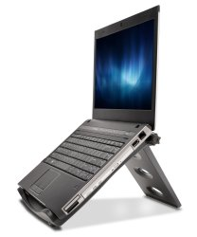
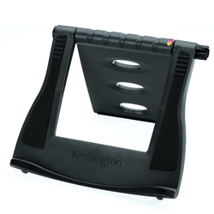
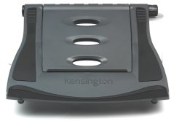
SmartFit™ Easy Riser Laptop Stand
Laptop stand with adjustable height to reduce neck and eye strain
Product description
The Easy Riser™ lifts your laptop to promote airflow, reducing strain on the laptop battery and circuitry. It also raises the screen to increase your comfort.
Product features
SmartFit™ system provides a customised monitor height adjustment in two easy steps
Up to 50 degree tilt angle
Padded inserts provide a secure, stable fit and keeps your laptops in place
Increases air circulation to keep your laptop cooler
Folds flat to travel easily
This product should be used with an external keyboard and mouse (sold separately)
Fits laptops 12" to 17"
SKU: 60112

