Slide 1
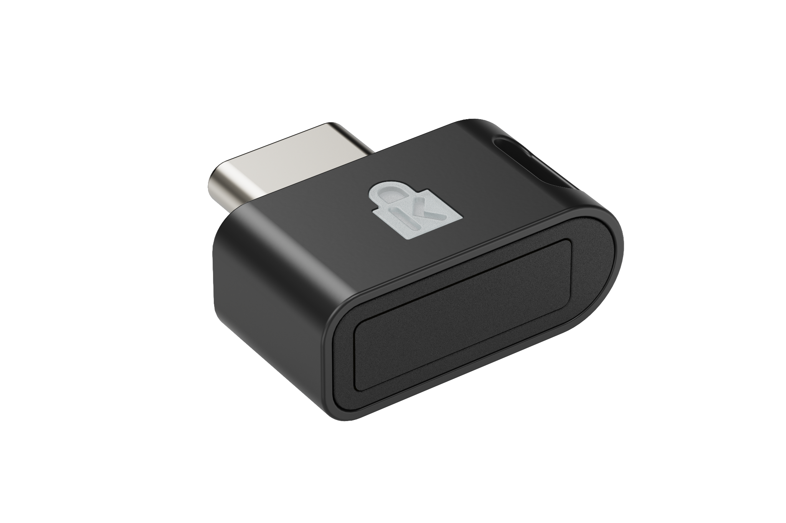

VeriMark™ IT 2.0 USB-C® Fingerprint Key
Seamless Windows Hello and WebAuthn Integration - Enables password-free login to Windows accounts, single sign-on to Microsoft 365 services, and WebAuthn authentication for supported websites without additional software.
SDCP & ESS Certified Security - Complies with Microsoft Secure Device Connection Protocol (SDCP) and Enhanced Sign-in Security (ESS)* to provide an added layer of biometric protection and isolate credentials from system-level threats.
Copilot PC+ Recall Ready - Meets Microsoft Copilot PC+ Recall requirements and supports ESS-compliant authentication for compatibility with current and emerging Windows enterprise security features.
Windows on x86 & ARM Compatible - Supports Windows 11 on x86 and ARM architectures, while maintaining full Windows Hello fingerprint functionality. Backwards compatible with Windows 10.
Reliable Fingerprint Recognition - 360° sensor delivers consistent, accurate authentication across common finger conditions in everyday use.
Match-in-Sensor™ Technology - Processes and stores biometric data entirely within the device, isolating credentials from the host system while delivering high-precision accuracy with FRR 2.2% and FAR 0.0001%.
Compact Design with Cap and Tether - Rugged zinc alloy construction with removable protective cap and tether cord for secure portability across shared and mobile work environments.
Supports Privacy and Regulatory Compliance - Designed to support cybersecurity practices aligned with privacy regulations such as GDPR, BIPA, and CCPA, and suitable for U.S. Federal Government use.
2-Year Limited Warranty - Backed by Kensington professional support and a 2-year limited warranty.
K64705WW
*Windows Hello Enhanced Sign-in Security requires a PC running Windows 11 with the latest updates.

