Slide 1

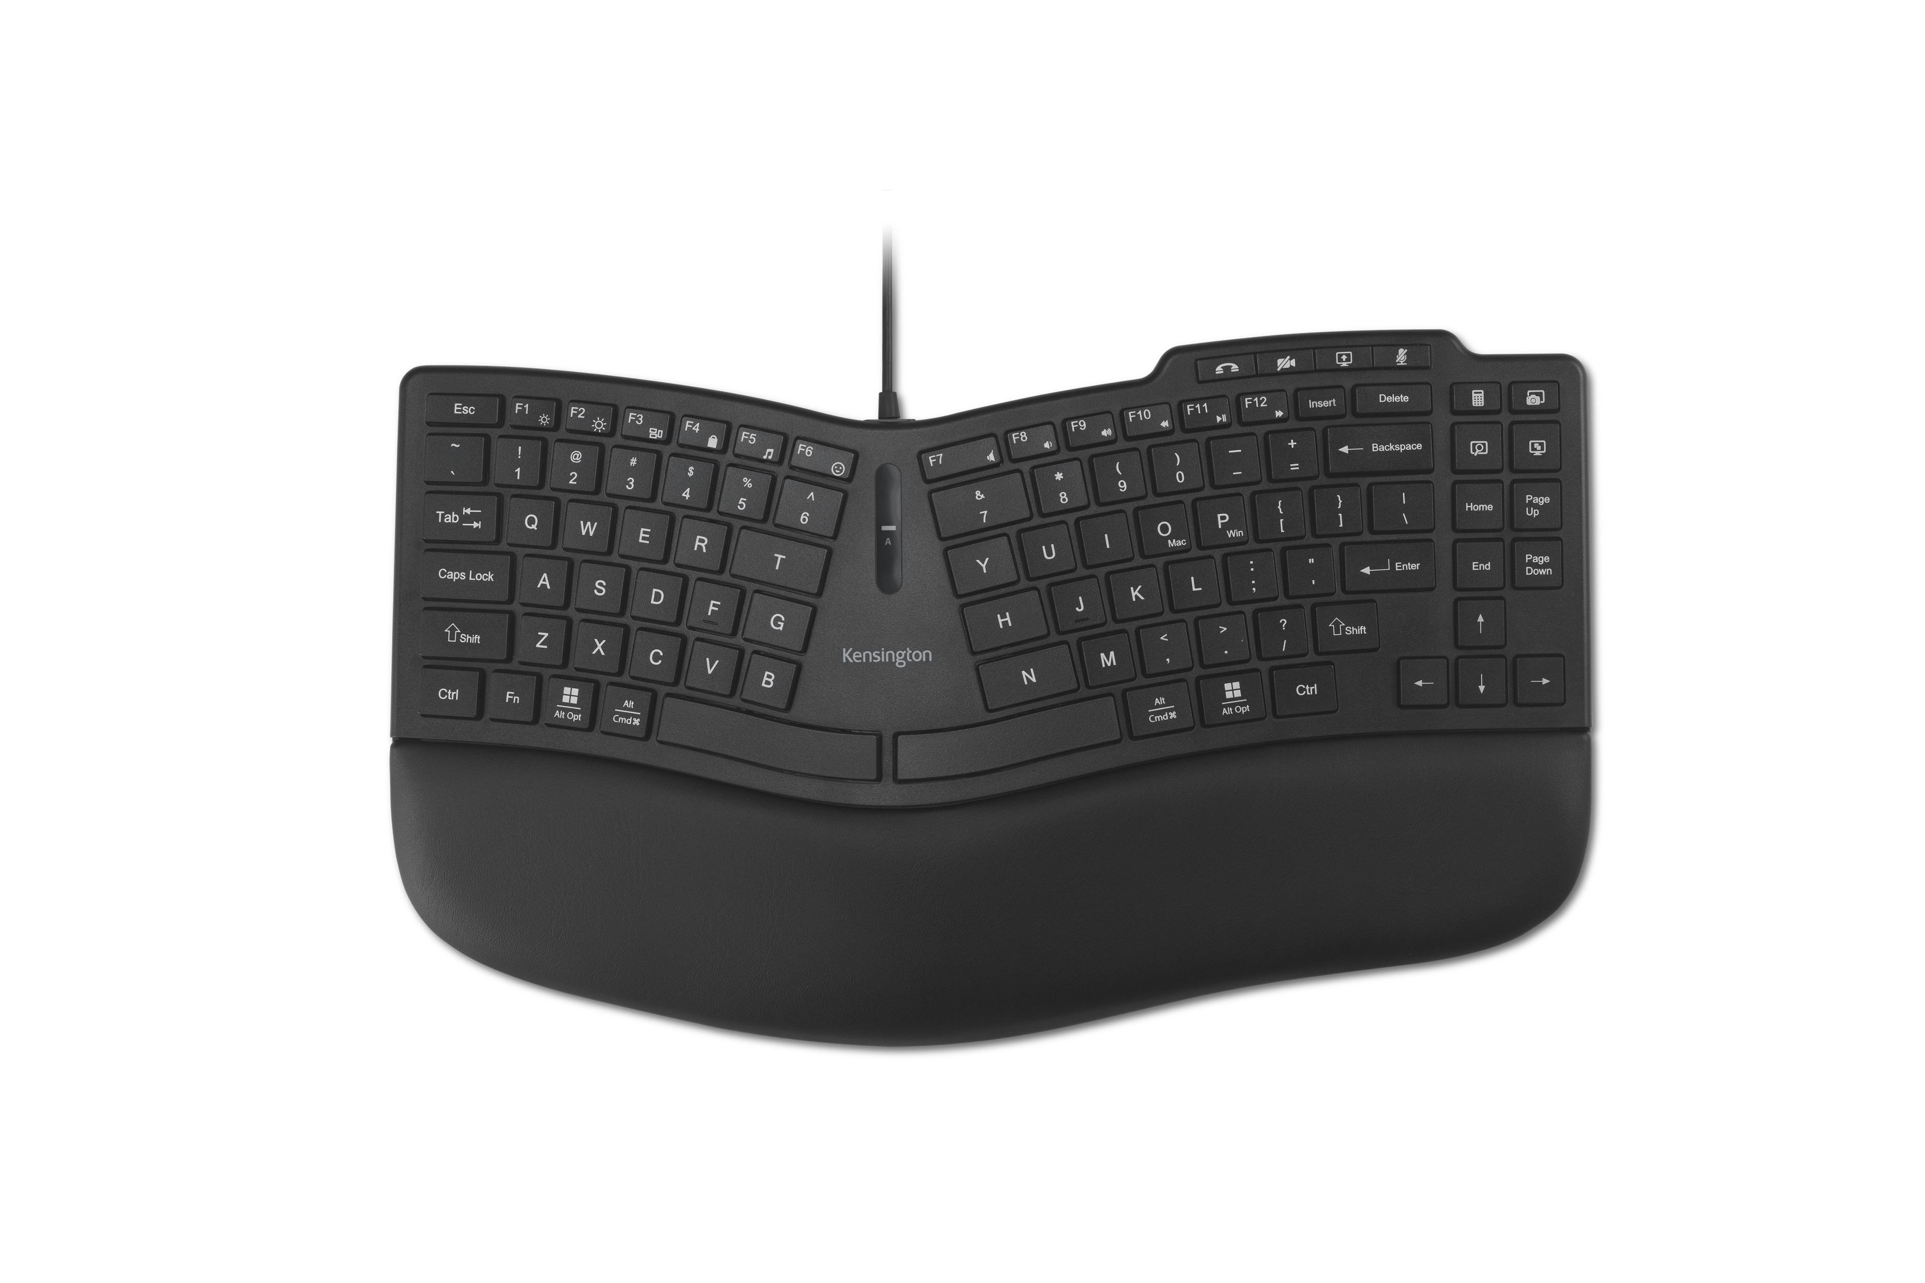
Pro Fit™ Ergo KB675 EQ TKL Wired Keyboard
Ergonomic Design
Compact curved key layout, built-in wrist pad, and front keyboard legs for all-day ergonomic comfort.
Reliable Wired Connection for Zero Latency Performance
Wired USB-A connection ensures zero lag – ensuring focus without the worries of battery life or signal dropouts.
Video Conferencing Keys
Supports efficient meeting transitions, offering quick access to mute, camera on/off, and screen share functions.
Customizable Keys
Program up to 20 keys, assign a dedicated shortcut to launch preferred AI application, create macros, adjust key mappings, manage profiles, and more with optional Kensington Konnect™ software.
Sustainability Attributes
Outer case and keycaps composed of 44% post-consumer recycled (PCR) content – and it is shipped in FSC® certified packaging.*
*Excludes PCB Assembly.
K75497NA

