Slide 1
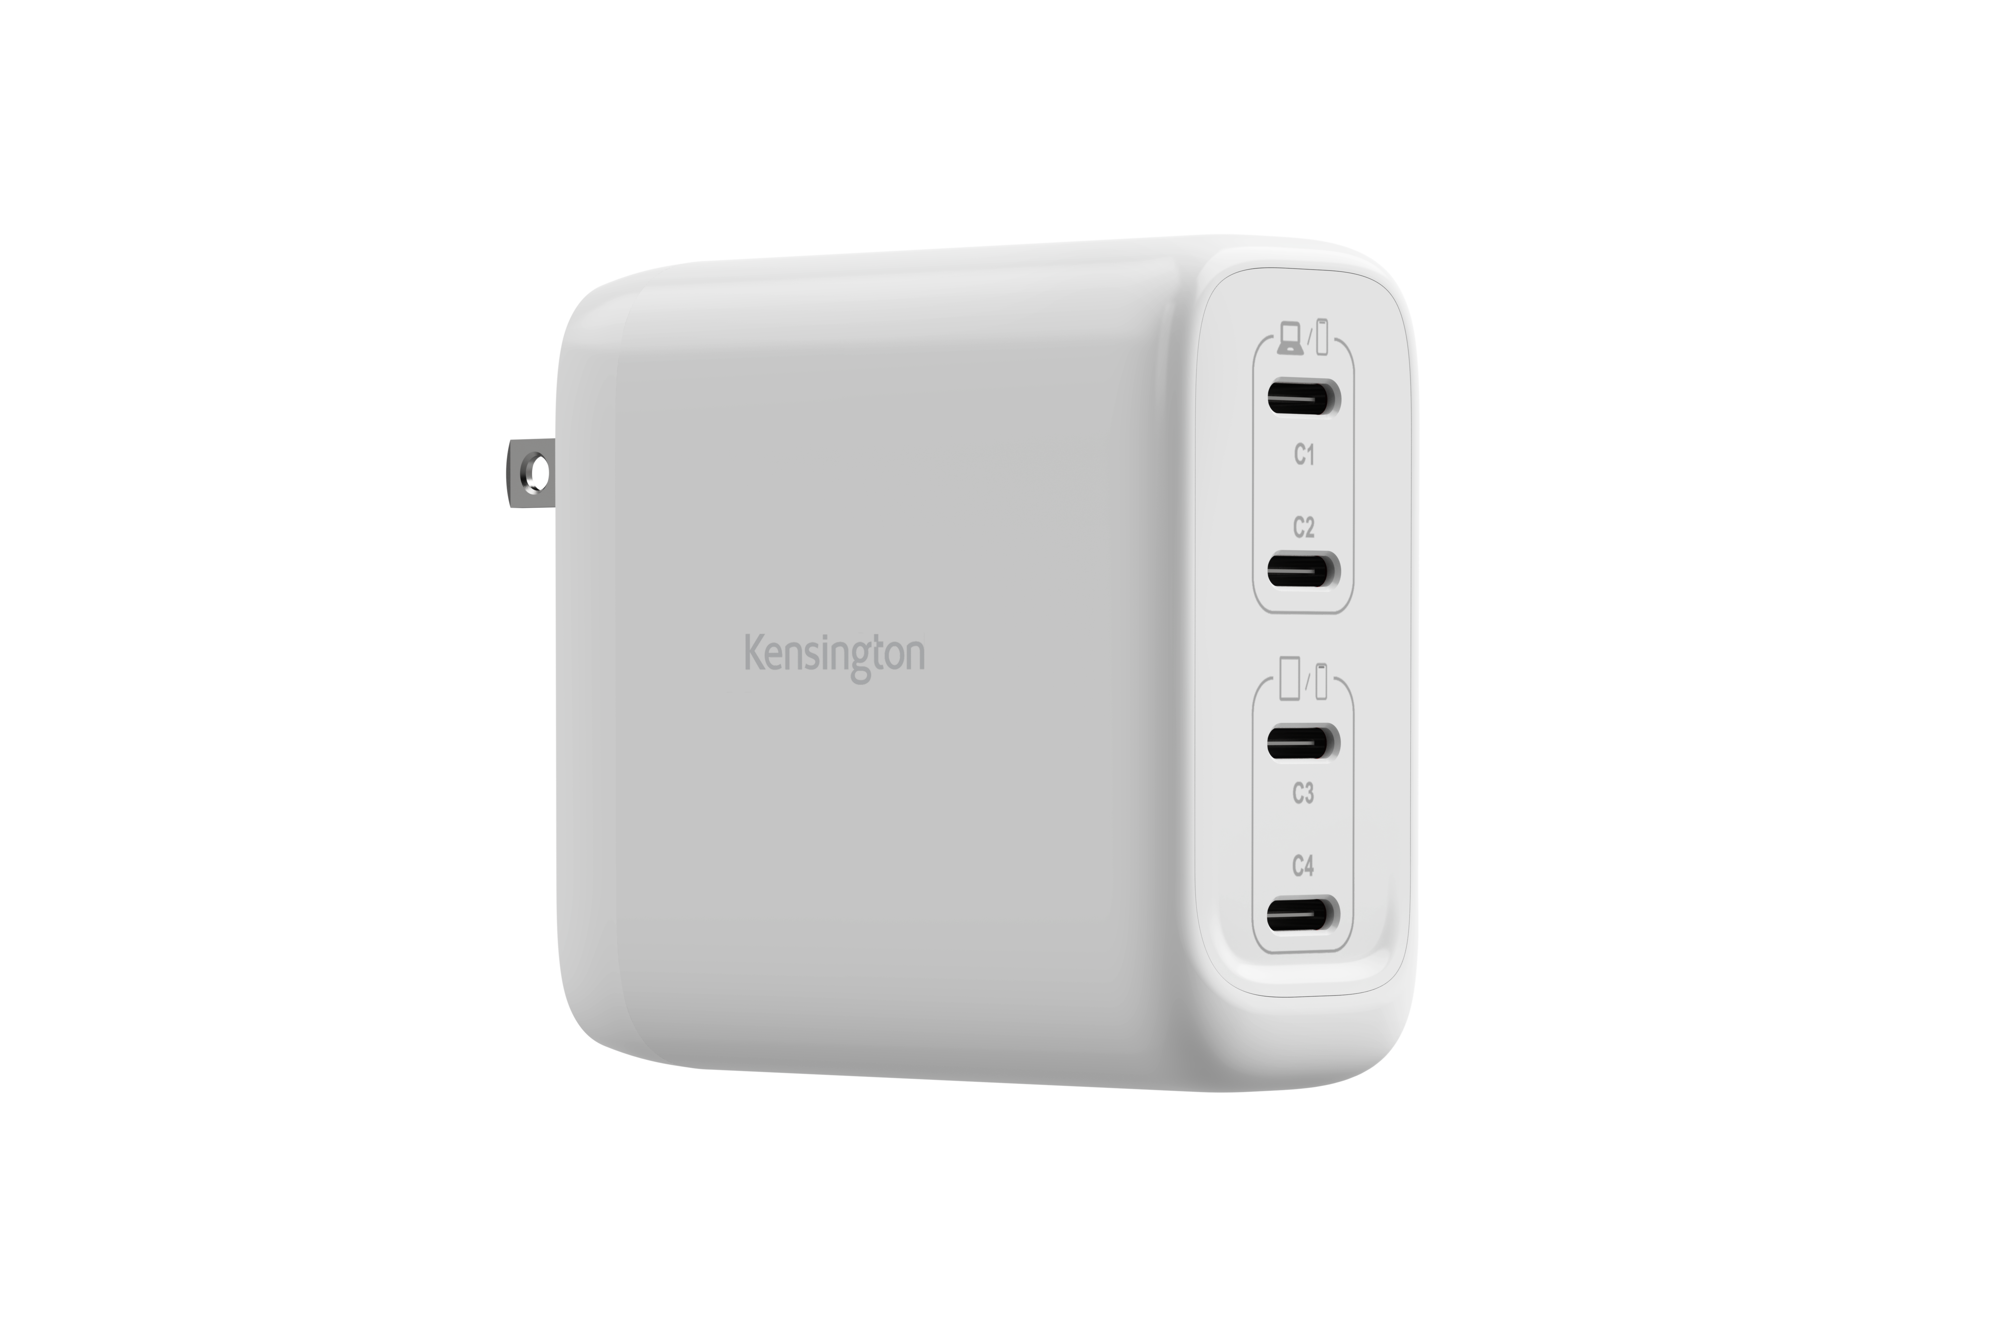
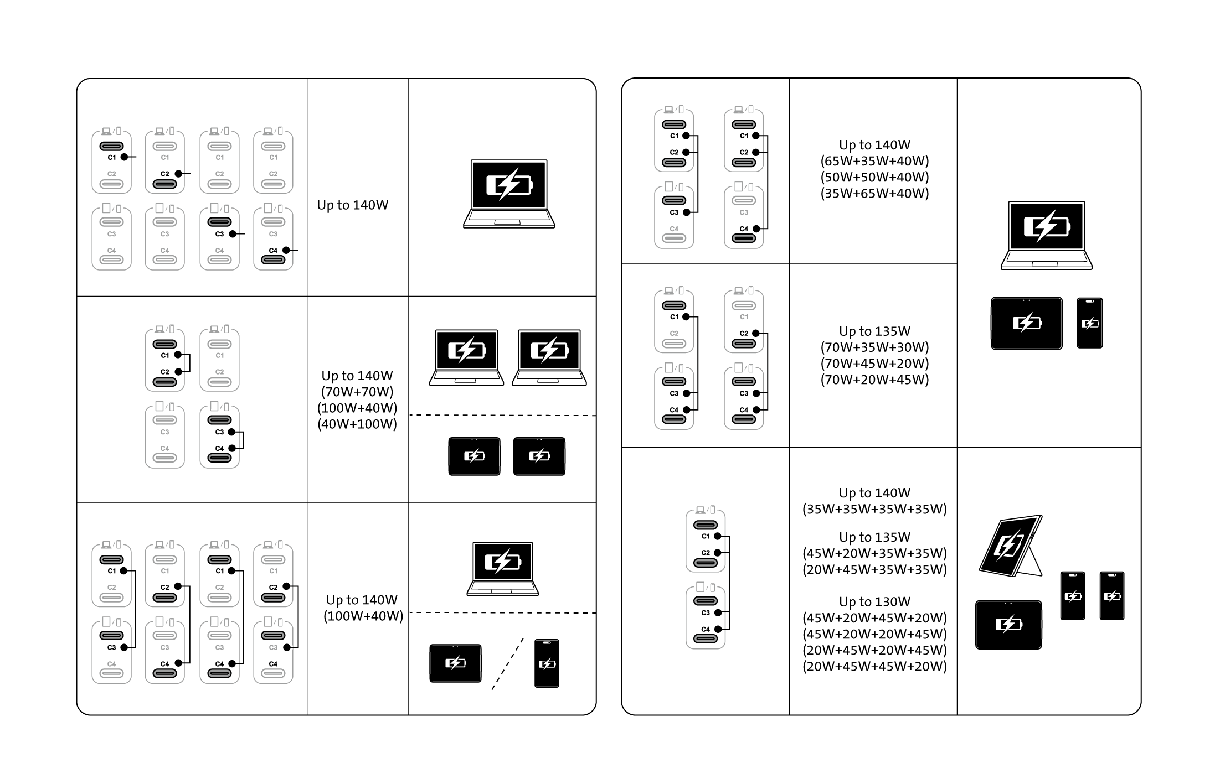

140W USB-C® GaN Power Adapter (4-Port Charger)
140W GaN Ultra-Fast Charger
Efficient high-speed power for laptops, tablets, and smartphones.
Broad Compatibility
USB-C® Extended Power Range (EPR) PD 3.1 for MacBooks, Windows & ChromeOS laptops, iPhones, iPads, Surface devices, and more.
Dual Laptop Charging
Two ports provide up to 70W each for simultaneous charging.
4-in-1 Charging
Four USB-C® ports share 140W to charge up to four devices simultaneously, delivering balanced power across all four ports.
Portable Design
Compact design with foldable plug.
Trusted Quality
Built to rigorous quality and safety standards, and backed by a 2-year limited warranty.
Cable Sold Separately
Use with an existing USB-C® cable or purchase our USB-IF Certified 6.6ft USB-C® Fast-Charging Cable (K32304WW; sold separately).
K38102NA

