Slide 1
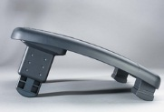
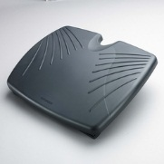
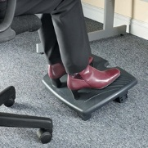
SoleRest™ FootRest
Product description
Footrests keep legs elevated for improved posture and circulation while you work at a desk and help reduce pressure on the lower back. They are easily adjustable for extra comfort, while there is a range of specifications available to suit individual requirements.
Product features
Multiple tilt options for personalised comfort
Contoured foot grip panel helps prevent slipping
Generous platform 450cm x 350cm (WxD)
Elevates legs to improve posture and circulation and reduce lower back pressure
Max height 18cm
12 Height and angle positions to support your feet
Cool graphite grey platform in tough, scratch resistant and easy to clean plastic
SKU: 56148

