Slide 1

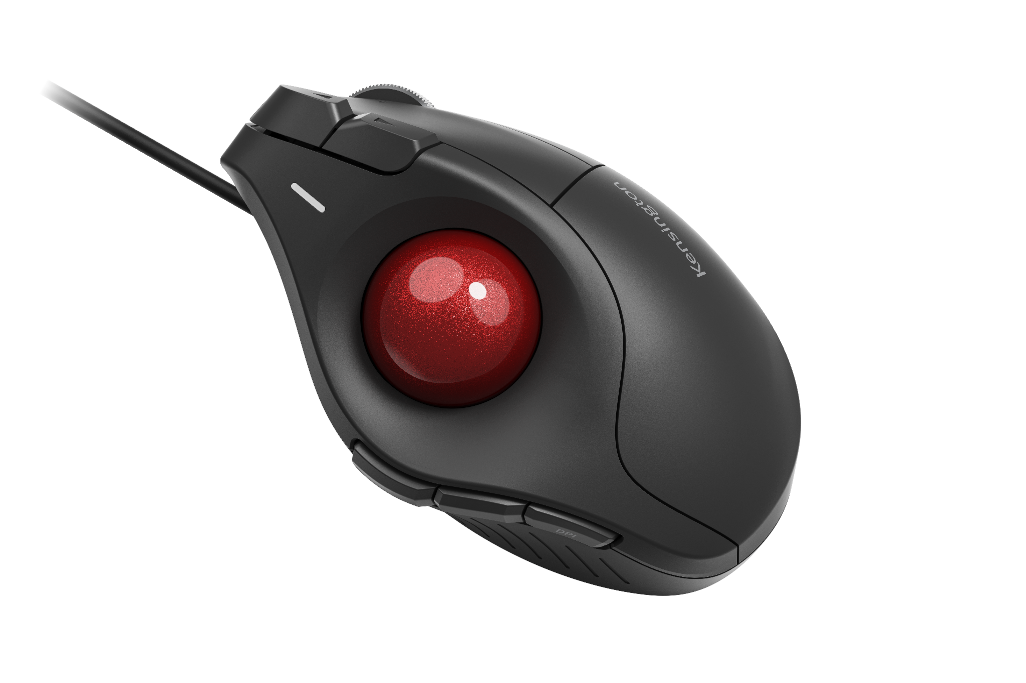
Pro Fit™ Ergo TB675 Vertical Wired Trackball
Ergonomist-Approved 60° Vertical Design
Contoured shape is designed to support more natural wrist and thumb positioning.
Plug & Play Wired Connection
Wired USB-C® connection with USB-A adapter delivers reliable performance.
Metal 4D Scroll Wheel
Supports smooth vertical scrolling and side-to-side navigation with a simple tilt.
High-Precision Optical Tracking
A high-precision optical sensor paired with a 34mm thumb-operated trackball delivers smooth, accurate cursor control and four DPI settings (400–1600).
9 Programmable Buttons
Customize shortcuts (via Kensington Konnect™) for one-touch access to your most-used commands.
Easy-Clean Design
Patented push-button trackball ejection—easily remove the ball for cleaning and
maintenance.
Kensington Quality and Red Dot Winner
Built to Kensington’s professional-grade standards and supported with a 3-year limited warranty.
K72170WWMY

