Slide 1

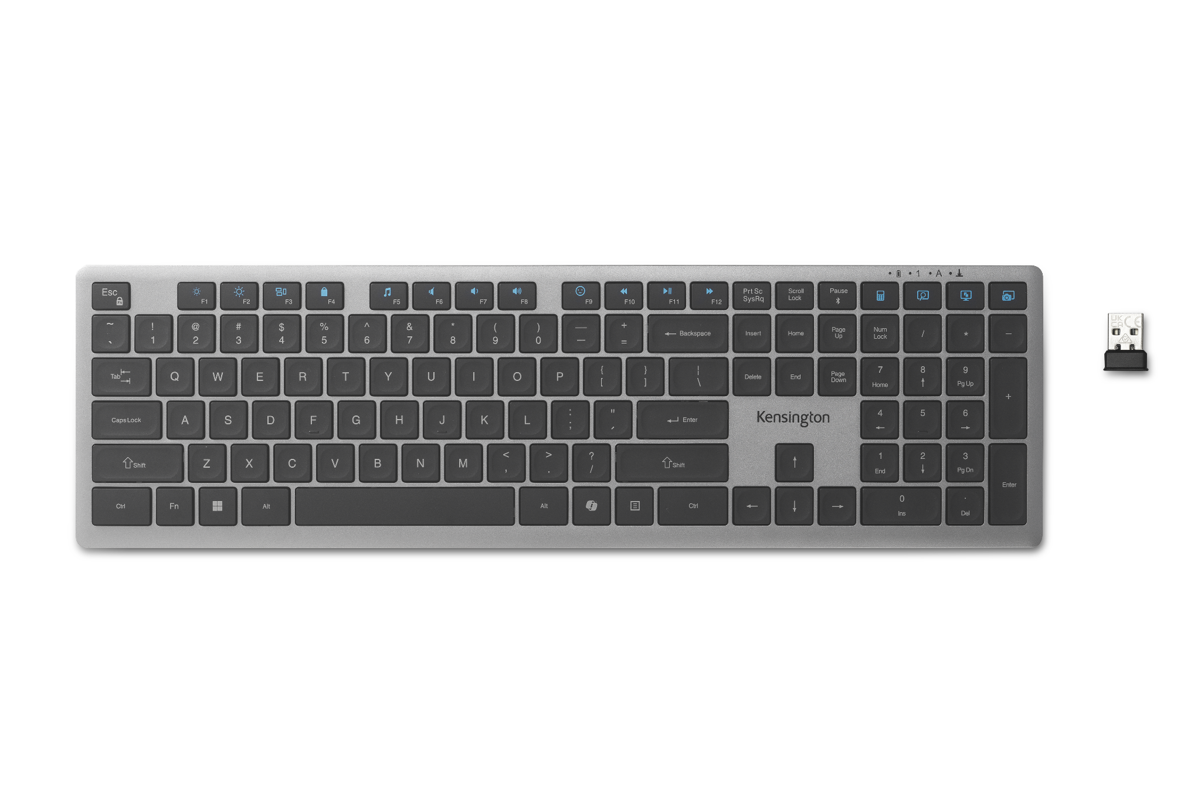
KB535 EQ Rechargeable Multi-Device Keyboard
Scissor-Switch Keys for Quiet, Responsive Typing - The scissor-switch keys provide a quiet and responsive feel, perfect for shared spaces. Designed for comfort, these keys reduce fatigue and ensure smooth, accurate typing.
16 Programmable Keys + Copilot Key + Function Lock for Enhanced Productivity - Tailor your keyboard to optimize workflows for complex tasks with 16 programmable keys, a dedicated Copilot AI key*, and Function Lock. Quickly access macros and key commands to support effortless multitasking.
Secure Multi-Device Connectivity - Connect up to 4 devices: 3 x Bluetooth® 5.4 and 1 x 2.4GHz USB-A receiver, featuring 128-bit AES encryption and a 10m range.
Rechargeable 500mAh Battery - Supports up to 4 months of productivity with a single charge.** Includes USB-A to USB-C® cable for charging.
LED Indicators for Status Updates - Status lights for Num Lock, Caps Lock, and Scroll Lock provide instant visibility into your keyboard's current settings.
Sustainability Attributes - The plastic in this keyboard is made with 41% post-consumer recycled (PCR) content*** and it is shipped in FSC® certified packaging.
Universal Compatibility - Compatible with Windows, macOS, and ChromeOS.
**** No drivers or downloads needed.
K75408NA
*Windows only.
**Battery life may vary based on usage.
***Excludes PCB assembly, rechargeable battery, 2.4GHz dongle, and charging cable.
****Copilot key works with Windows only.

