Slide 1
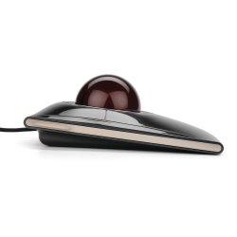
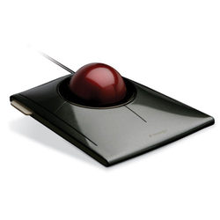
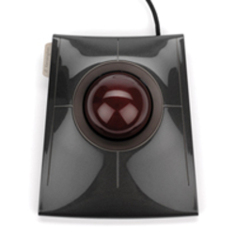
SlimBlade™ Trackball
Product description
Comfort and productivity are at your fingertips with the SlimBlade Trackball. Your computing experience gets smoother, faster and easier with a ball that can do it all. In addition to the usual productivity gains that come with a trackball, with a simple twist of the ball, you’ll be scrolling up and down pages. It offers better ergonomics, with less wrist and hand movement that will ease the pain of repetitive-stress injuries
Scroll up and down web pages and documents with a simple twist of the 55mm ball
Sleek, low-profile design offers all-day comfort along with beautiful aesthetics
Laser tracking technology delivers superior precision for increased productivity
Ambidextrous design ideal for both right-handed and left-handed users
Free Trackball Works™ software allows you to customize buttons, cursor and scrolling speeds
Product features
SKU: K72327EU

