Slide 1
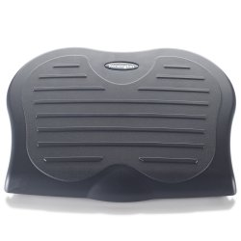
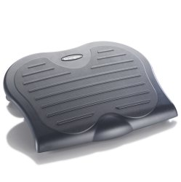
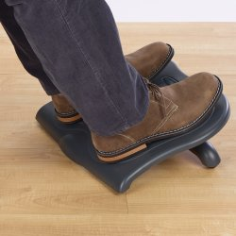
SoleSaver™ FootRest
Product description
Footrests keep legs elevated for improved posture and circulation while you work at a desk and help reduce pressure on the lower back. They are easily adjustable for extra comfort, while there is a range of specifications available to suit individual requirements.
Product features
Three tilt options for personalised comfort. 10, 15 and 20 degrees
Contoured foot grip panel helps prevent slipping
Generous platform 450cm x 350cm (WxD)
Elevates legs to improve posture and circulation and reduce lower back pressure
Helps reduce pressure on lower back and alleviate discomfort from sitting
SKU: 56152

