Slide 1
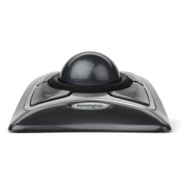
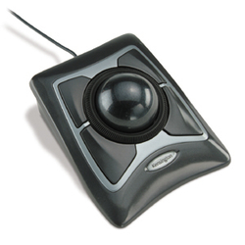
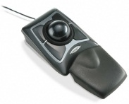
Expert Mouse
Product description
The Expert Mouse Wired Trackball is the ultimate productivity enhancer that makes working at the desk quicker, more accurate and extremely comfortable for your hand and wrist. Featuring Diamond Eye technology, the trackball uses optical tracking to precisely follow small flecks embedded in the large 55mm ball to provide smooth, accurate cursor control
Trackball Works™ lets you customize all 4 buttons, set cursor speed
Diamond Eye™ optical tracking technology for premium cursor control and accuracy
Award-winning Scroll Ring lets you scan up and down pages with ease
Large 55mm ball is designed as a perfect sphere to provide exceptional precision
Detachable wrist rest supports hand and wrist for ergonomic comfort
Product features
SKU: 64325

