Slide 1
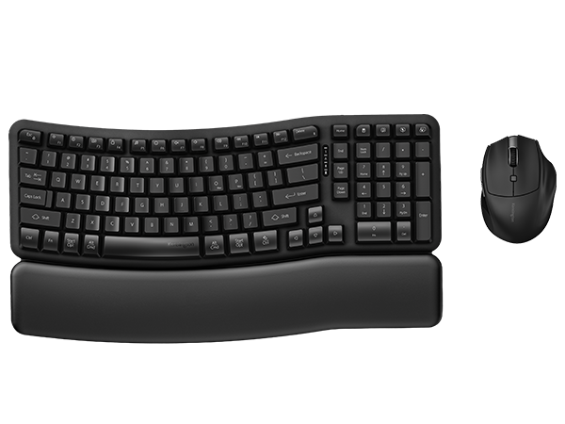

Pro Fit™ Ergo KM620-RC Wireless Rechargeable EQ Desktop Set
post-consumer recycled
Ergonomic Wave Design Keyboard with Built-In Wrist Rest
Designed for an easy transition from traditional non-ergonomic keyboards, the gently curved layout combines an integrated memory foam wrist rest with adjustable tilt options.
Comfortable 6-Button Mouse
Designed for right-handed users with small to average-sized hands, the mouse features quiet-click buttons, an optical sensor with 3 DPI settings (1000/1600/2400) for accurate tracking, and 6 buttons to streamline everyday productivity.
Customizable Productivity
Program up to 20 keys and 6 buttons with optional Kensington Konnect™ software.***
Quiet, Responsive Performance
Membrane keyboard switches deliver smooth, low-noise typing, while quiet-click mouse buttons support distraction free productivity.
Long-Lasting Rechargeable Batteries
Up to 3 months for the keyboard and up to 6 months for the mouse per charge.* Recharge via USB-C®.
1800 Layout
Full functionality including numeric keypad.
Multi-Device Wireless Connectivity
Connect to up to 3 devices via 2x Bluetooth® and 1x 2.4GHz USB-A receiver.
Sustainability Attributes
Keyboard outer case and keycaps contain 49% post-consumer recycled (PCR) Content. Mouse outer case is made with 40% post-consumer recycled (PCR) plastic.**
Kensington Quality & Warranty
Built to professional standards and backed by a 3-year limited warranty.
K72490NA
*Battery life may vary based on usage.
**Excludes scroll wheel and DPI button.
***Programmable buttons and shortcuts are optimized for Windows and macOS. ChromeOS shortcuts and customization features may not be supported.

