Slide 1
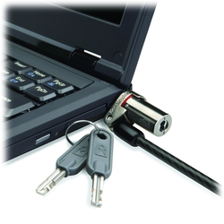
MicroSaver® DS Ultra Thin Laptop Lock
Product description
Ultrabook and MacBook laptops are valuable business tools, and desirable for thieves, but they are frequently too thin for a standard cable lock, or lack a Kensington Security Slot. The MicroSaver® DS Ultra-Thin Laptop Lock has a sleek profile, rotating head, and even a Kensington Security Slot adapter for laptops without the slot
Product features
Slim enough to work on even the thinnest Ultrabook
Rotating head and pivoting cable for easy lock attachment and removal
Includes attractive K-slot adapter for Macbook Air and Ultrabooks lacking a K-slot
Patented T-bar locking mechanism for superior strength
Multi-stranded 1500mm long, 4mm thick high-carbon aircraft-grade steel cable
SKU: K64994EU- With Puck K66533WW- Without Puck K64995WW- Puck Only

