Slide 1
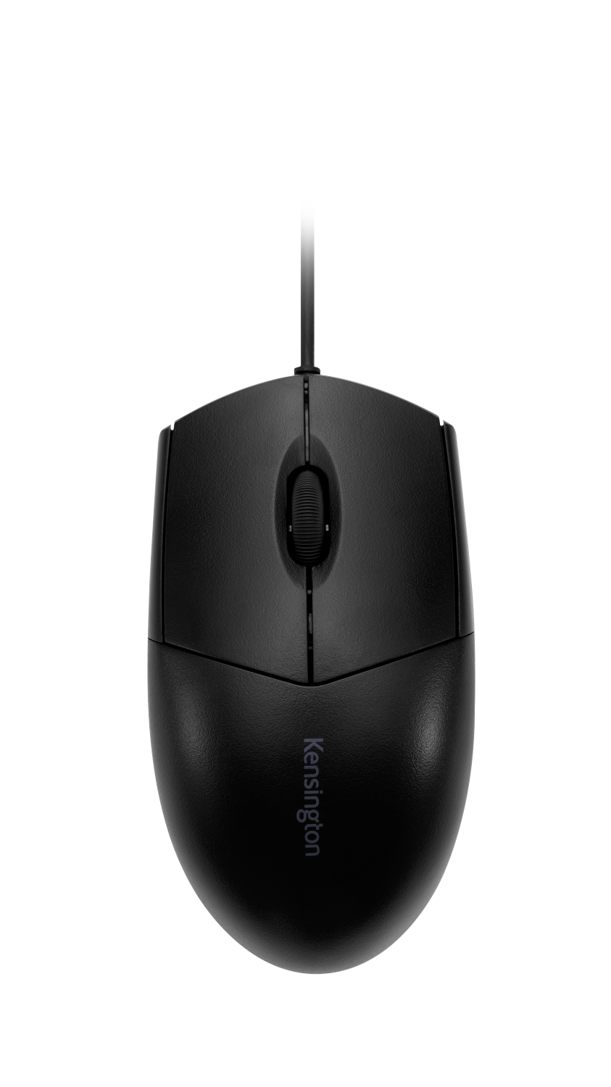
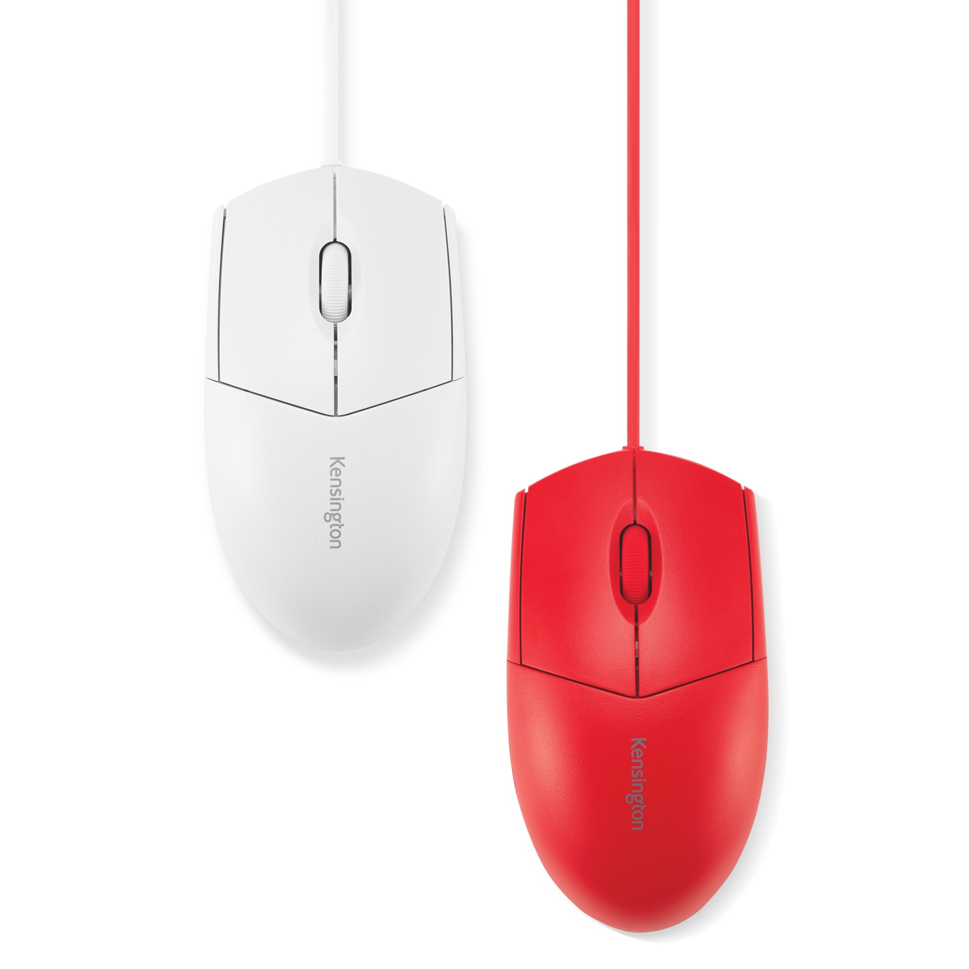
Pro Fit™ Wired Washable Mouse
Waterproof, Washable Design - Rated to IP67 standards for water and dust protection. It can be safely washed by immersion* or sprayed with disinfectant cleaners..
Wipe-Down Protection - Meets MIL-STD-810H Method 504.3 Contamination by Fluids testing, demonstrating resistance to breakdown when exposed to cleaning and disinfecting solvents.
Wired USB-A Connection - The wired connection ensures a reliable plug-and-play experience—no drivers or batteries needed.
High-Definition 1600 DPI Optical Sensor - Responsive tracking on typical office surfaces.
Ambidextrous, Contoured Design - Comfortable ambidextrous design withthree-button scroll wheel layout.
Perfect Companion to Pro Fit™ Washable Keyboard - Complements Pro Fit™ Wired Washable Keyboard for a cohesive workspace that is easy to sanitize.
3-Year Limited Warranty - Built for durability.
*USB connector should not be submerged.
Red
White
Black
K75239US
K75240US
K70315WW

