Slide 1
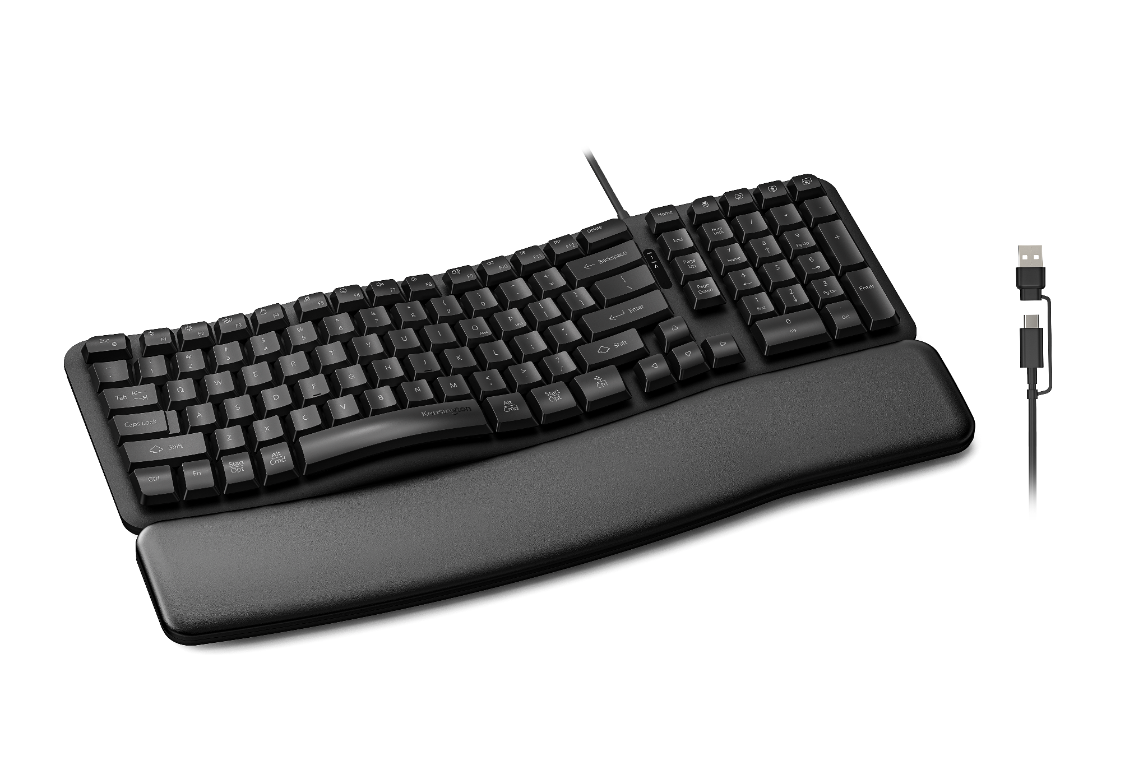

Pro Fit™ Ergo KB620-W Wired EQ Keyboard
post-consumer recycled
Ergonomic Wave Design with Built-In Wrist Rest
Easy to transition to, and includes integrated memory foam wrist rest and multiple tilt options.
Quiet, Responsive Typing
Low-noise membrane switches deliver smooth, distraction-free performance.
Programmable Keys*
Up to 20 programmable keys enable personalized shortcuts and workflow efficiency.
1800 Layout
Space-saving layout delivers full functionality in a smaller desktop footprint.
LED Status Indicators
Clear visual feedback for Num Lock and Caps Lock status.
Reliable Wired Connection
Zero-lag USB-C® performance with included USB-A adapter for broad compatibility. Compatible with Windows, macOS, and ChromeOS.
Sustainability Attributes
Outer case and keycaps contain 50% post-consumer recycled content and ships in FSC® certified packaging.
Kensington Quality & Warranty
Tested for durability and backed by a 3-year limited warranty.
K72506NA
*Programmable buttons and shortcuts are optimized for Windows and macOS. Some ChromeOS shortcuts and customization features may not be supported.

